Slide 1
POLITICAL FOCUS – WHY & HOW?

Slide 2
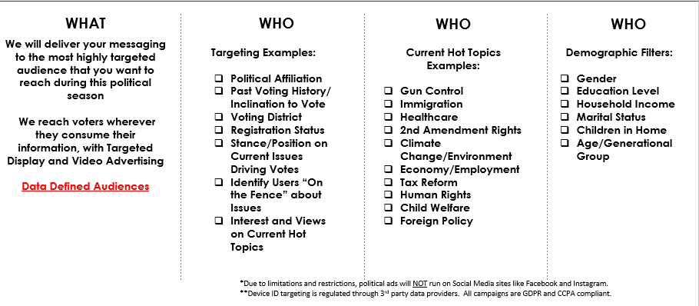
POLITICAL FOCUS – WHAT & WHO?

