Slide 1


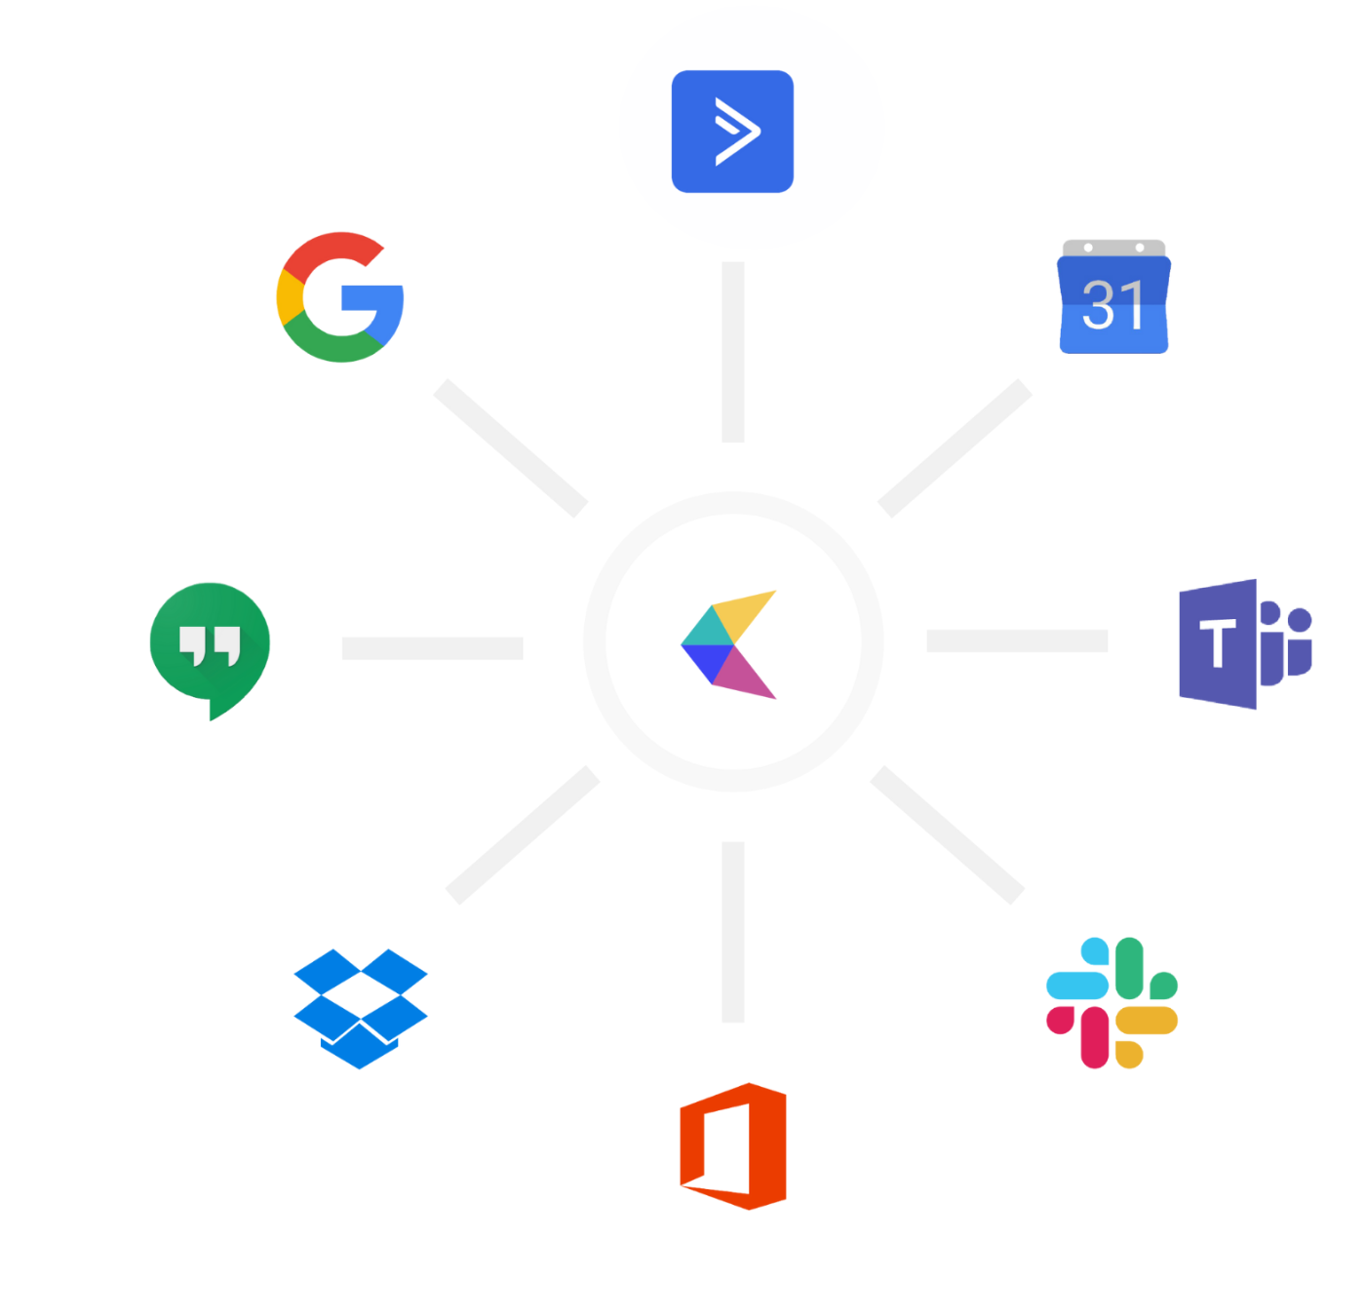
+
CalendarHero + ActiveCampaign
Drive booking rates and revenue by integrating
CalendarHero and ActiveCampaign.

Slide 2
Table of Contents
Product Intro: CalendarHero & ActiveCampaign
Integration Overview
Bring more value to small to medium-size businesses

Slide 3
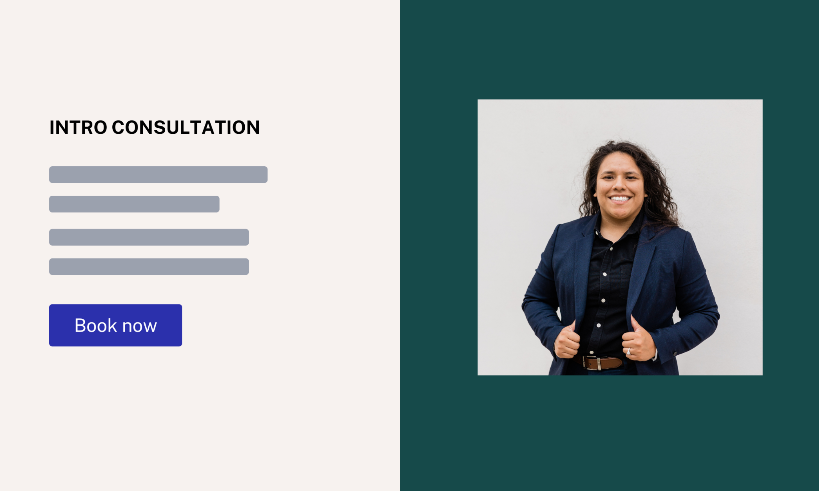
ActiveCampaign
ActiveCampaign gives you the email marketing, marketing automation, and CRM tools you need to create incredible customer experiences.
CalendarHero
CalendarHero gives you everything you need to automate bookings, reminders, payments, and more to strengthen customer experiences and increase revenue.

Slide 4
How does ActiveCampaign and CalendarHero work together?
Back to Table of Contents ↗

Slide 5
1. Sync contacts and simplify scheduling
Sync your ActiveCampaign contacts to CalendarHero in real time to schedule 1:1, group, and remote meetings automatically.
Display your real-time availability with a CalendarHero link — contacts can self-book meetings on-demand, at times that work for everyone.
Create unique meeting types (templates) for different audiences and campaigns. Track scheduling progress and meeting metrics.
Reduce no-shows — send your contacts automated reminders and meeting notifications.

Slide 6
2. Prove campaign ROI with a meeting call to action
Convert email opens into booked meetings, event registrations, or paid appointments directly from your ActiveCampaign email campaigns.
Book leads at the height of interest — share a CalendarHero link for a meeting, appointment, or event directly in your automated email campaigns.
Turn on secure payment collection in CalendarHero to drive revenue from bookings simultaneously.
Pre-qualify leads before you meet by inserting questions into your scheduling experience automatically.

Slide 7
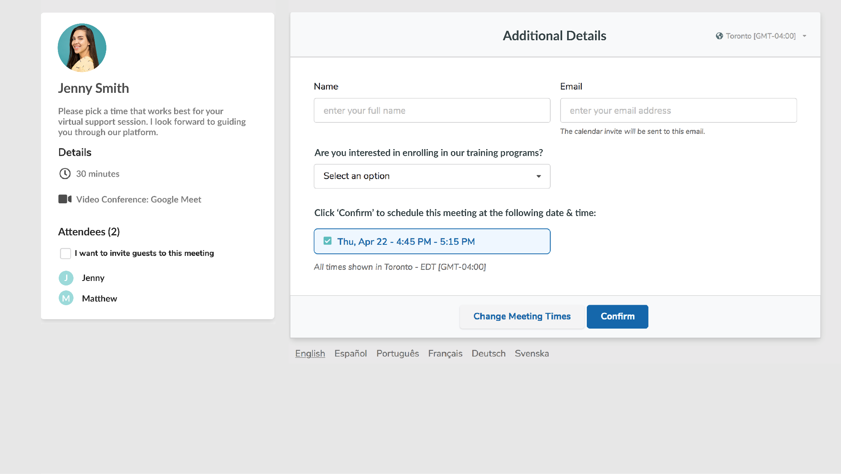

Slide 8
How does bundling ActiveCampaign & CalendarHero together help customers?
Back to Table of Contents ↗

Slide 9
1. Automated scheduling helps businesses grow
Conventional scheduling is becoming a thing of the past. Businesses with an online scheduling tool see better results & have a competitive edge.
Market insights:
The appointment scheduling software market is predicted to increase by $633.47 million between 2021 and 2025 (Source: PR Newswire, 2021)
94 % of customers are more likely to choose a new service provider if that provider offered an online booking option (Source: GetApp, 2021)
Online scheduling leads to 26% more new customers (Source: Yocale, 2021)

Slide 10
2. Drive bookings and more revenue for your clients
Help your customers strengthen the results of their email campaigns, boost their booking rates, and drive revenue through a fully-integrated scheduling workflow.
With CalendarHero + ActiveCampaign, SMB clients can:
Increase book rates — quickly book meetings with contacts directly after they open an email
Reduce no-shows with automated reminders
Share real-time availability with prospects and customers
Collect payments with bookings simultaneously

Slide 11
